Slide 1

Logistic Regression

Slide 2
What is Logistic Regression?
Logistic regression is one of the most popular Machine Learning algorithms, which comes under the Supervised Learning technique.
It is used for predicting the categorical dependent variable using a given set of independent variables.
Logistic regression predicts the output of a categorical dependent variable.
Therefore the outcome must be a categorical or discrete value.
It can be either Yes or No, 0 or 1, true or False, etc. but instead of giving the exact value as 0 and 1, it gives the probabilistic values which lie between 0 and 1.
Logistic Regression is much similar to the Linear Regression except that how they are used.
Linear Regression is used for solving Regression problems, whereas Logistic regression is used for solving the classification problems.

Slide 3
In Logistic regression, instead of fitting a regression line, we fit an "S" shaped logistic function, which predicts two maximum values (0 or 1).
The curve from the logistic function indicates the likelihood of something such as whether the cells are cancerous or not, a mouse is obese or not based on its weight, etc.
Logistic Regression is a significant machine learning algorithm because it has the ability to provide probabilities and classify new data using continuous and discrete datasets.
Logistic Regression can be used to classify the observations using different types of data and can easily determine the most effective variables used for the classification.

Slide 4
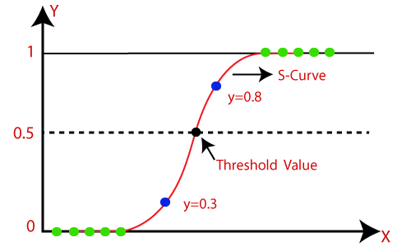
The below image is showing the logistic function:
Note: Logistic regression uses the concept of predictive modeling as regression; therefore, it is called logistic regression, but is used to classify samples. Therefore, it falls under the classification algorithm.

Slide 5
Comparison to Linear Regression
Linear Regression could help us predict the student’s test score on a scale of 0 - 100.
Linear regression predictions are continuous (numbers in a range).
Logistic Regression could help use predict whether the student passed or failed. Logistic regression predictions are discrete (only specific values or categories are allowed).
We can also view probability scores underlying the model’s classifications.

Slide 6
Types of Logistic Regression
Binomial
In such a kind of classification, a dependent variable will have only two possible types either 1 and 0.
For example, these variables may represent success or failure, yes or no, win or loss etc.
Multinomial
In such a kind of classification, dependent variable can have 3 or more possible unordered types or the types having no quantitative significance.
For example, these variables may represent “Type A” or “Type B” or “Type C”.
Ordinal
In such a kind of classification, dependent variable can have 3 or more possible ordered types or the types having a quantitative significance.
For example, these variables may represent “poor” or “good”, “very good”, “Excellent” and each category can have the scores like 0,1,2,3.

Slide 7
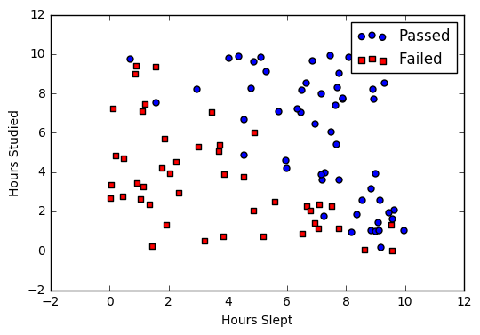
Binomial: In binomial Logistic regression, there can be only two possible types of the dependent variables, such as 0 or 1, Pass or Fail, etc.
Say we’re given data on student exam results and our goal is to predict whether a student will pass or fail based on number of hours slept and hours spent studying.
We have two features (hours slept, hours studied) and two classes: passed (1) and failed (0).
Studied | Slept | Passed
4.85 | 9.63 | 1
8.62 | 3.23 | 0
5.43 | 8.23 | 1
9.21 | 6.34 | 0

Slide 8

Sigmoid activation
In order to map predicted values to probabilities, we use the sigmoid function.
The function maps any real value into another value between 0 and 1.
In machine learning, we use sigmoid to map predictions to probabilities.
Math
S(z)=$1/(1+e^{−z})$
s(z) = output between 0 and 1 (probability estimate)
z = input to the function (your algorithm’s prediction e.g. mx + b)
e = base of natural log

Slide 9
Steps in Logistic Regression
To implement the Logistic Regression using Python, we will use the same steps as we have done in previous topics of Regression. Below are the steps:
Data Pre-processing step
Fitting Logistic Regression to the Training set
Predicting the test result
Test accuracy of the result(Creation of Confusion matrix)
Visualizing the test set result.

Slide 10
Prepare Data for Logistic Regression
Binary Output Variable:
This might be obvious as we have already mentioned it, but logistic regression is intended for binary (two-class) classification problems.
It will predict the probability of an instance belonging to the default class, which can be snapped into a 0 or 1 classification.
Remove Noise:
Logistic regression assumes no error in the output variable (y), consider removing outliers and possibly misclassified instances from your training data.
Gaussian Distribution:
Logistic regression is a linear algorithm (with a non-linear transform on output). It does assume a linear relationship between the input variables with the output.
Data transforms of your input variables that better expose this linear relationship can result in a more accurate model. For example, you can use log, root, Box-Cox and other univariate transforms to better expose this relationship.

Slide 11
Remove Correlated Inputs:
Like linear regression, the model can overfit if you have multiple highly-correlated inputs.
Consider calculating the pairwise correlations between all inputs and removing highly correlated inputs.
Fail to Converge:
It is possible for the expected likelihood estimation process that learns the coefficients to fail to converge.
This can happen if there are many highly correlated inputs in your data or the data is very sparse (e.g. lots of zeros in your input data).

Slide 12
Logistic Regression Assumptions
Before diving into the implementation of logistic regression, we must be aware of the following assumptions about the same −
In case of binary logistic regression, the target variables must be binary always and the desired outcome is represented by the factor level 1.
There should not be any multi-collinearity in the model, which means the independent variables must be independent of each other .
We must include meaningful variables in our model.
We should choose a large sample size for logistic regression.

Slide 13
Linear Regression | Logistic Regression
Linear Regression is a supervised regression model. | Logistic Regression is a supervised classification model.
In Linear Regression, we predict the value by an integer number. | In Logistic Regression, we predict the value by 1 or 0.
Here no activation function is used. | Here activation function is used to convert a linear regression equation to the logistic regression equation
Here no threshold value is needed. | Here a threshold value is added.
Here we calculate Root Mean Square Error(RMSE) to predict the next weight value. | Here we use precision to predict the next weight value.
Here dependent variable should be numeric and the response variable is continuous to value. | Here the dependent variable consists of only two categories. Logistic regression estimates the odds outcome of the dependent variable given a set of quantitative or categorical independent variables.
It is based on the least square estimation. | It is based on maximum likelihood estimation.

Slide 14
Linear Regression | Logistic Regression
Here when we plot the training datasets, a straight line can be drawn that touches maximum plots. | Any change in the coefficient leads to a change in both the direction and the steepness of the logistic function. It means positive slopes result in an S-shaped curve and negative slopes result in a Z-shaped curve.
Linear regression is used to estimate the dependent variable in case of a change in independent variables. For example, predict the price of houses. | Whereas logistic regression is used to calculate the probability of an event. For example, classify if tissue is benign or malignant.
Linear regression assumes the normal or gaussian distribution of the dependent variable. | Logistic regression assumes the binomial distribution of the dependent variable.

